Slide 1
ODME Project Printers
NASA MSFC EM42

Slide 2
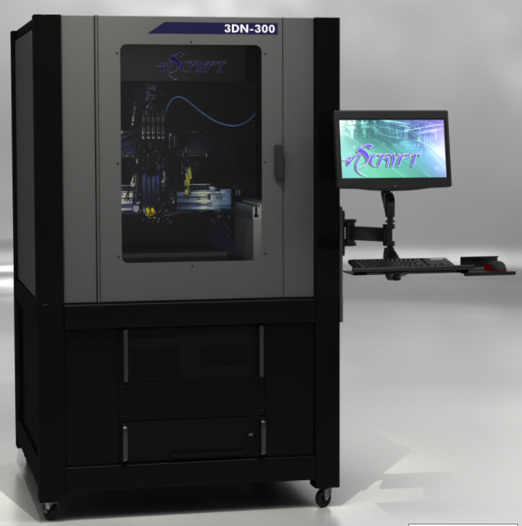
nScrypt 3Dn-300 multi-material printer
https://www.nscrypt.com/
4 gizmos at a time
SmartPump (direct write thick film print head)
pentip as small as 10um, printed lines as small as 20um, and dots as small as 50um
nFD (polymer fused filament fabrication print head)
Heated bed
Laser (curing/sintering of inks)
nMill (drill head attachment for milling)
Pick and Place

Slide 3
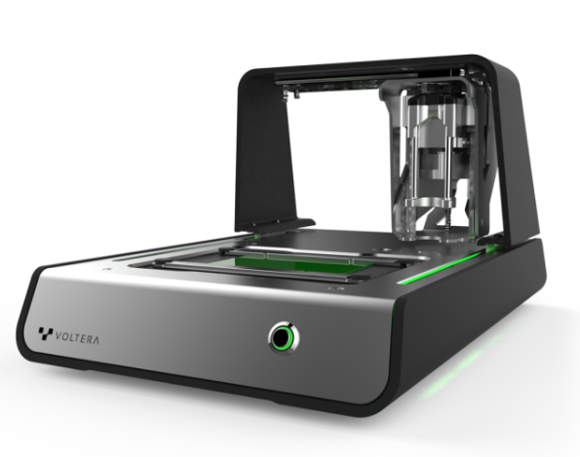
Voltera V-One thick film printer
https://www.voltera.io/product
Benchtop printer designed for the quick printing of simple circuit boards
Thick film inks which can be cured with a heated bed or in the oven
Minimum trace width of 0.2mm

Slide 4
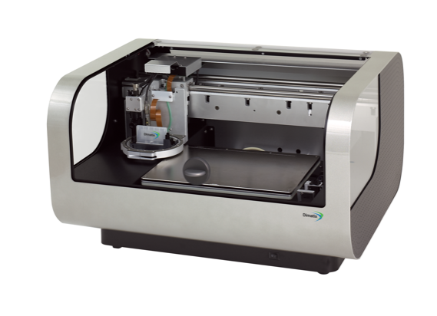
Dimatix DMP-2850 ink jet printer
https://www.fujifilm.com/us/en/business/inkjet-solutions/inkjet-technology-integration/dmp-2850
Prints with a piezo inkjet cartridge
Can create and define patterns over an area of about 200 x 300 mm and handle substrates up to 25 mm thick with an adjustable Z height
Materials cured with a heated bed or in the oven
UV curing attachment is an option

